Slide 1

VIRTUAL ASSISTANT

Slide 2
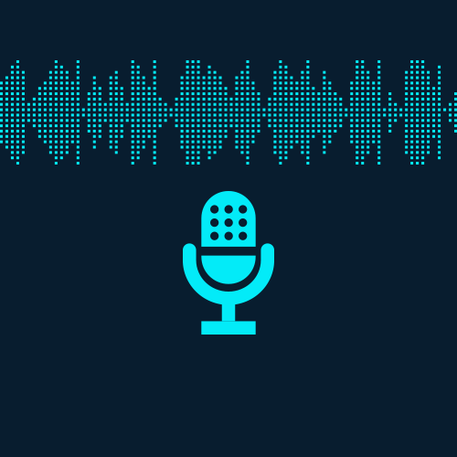
It comes under the area of ,
Natural Language Processing
Speech Recognition
Convolutional Neural Network ( CNN )
The device will convert the analog sound waves of the voice into a digital waveform that’s basically a string of numbers.
That, in turn, becomes a spectrogram which is broken up into frames processed to find the phonemes (i.e. the letters of the spoken language) that each frame contains.
The phonemes found in the frames are then compared to a phonetic dictionary to identify what’s been said.
A Spectrogram is a visual representation of the various frequencies of sound as they vary with time.
An image is nothing but a matrix of pixel values

Slide 3
It is very common to convert the voice clips to spectrograms and then use a CNN (Convolutional Neural Network) to classify this.
A convolutional neural network (CNN) is a specific type of artificial neural network that uses Perceptron.
Perceptron is a machine learning unit algorithm, for supervised learning, to analyze data.
It also helps to classify the given input data.
CNNs apply to image processing, natural language processing and other kinds of cognitive tasks.
Automated speech recognition (ASR)
Natural language processing (NLP).
ASR is the conversion of spoken word to text while NLP is the processing of the text to derive its meaning.

Slide 4
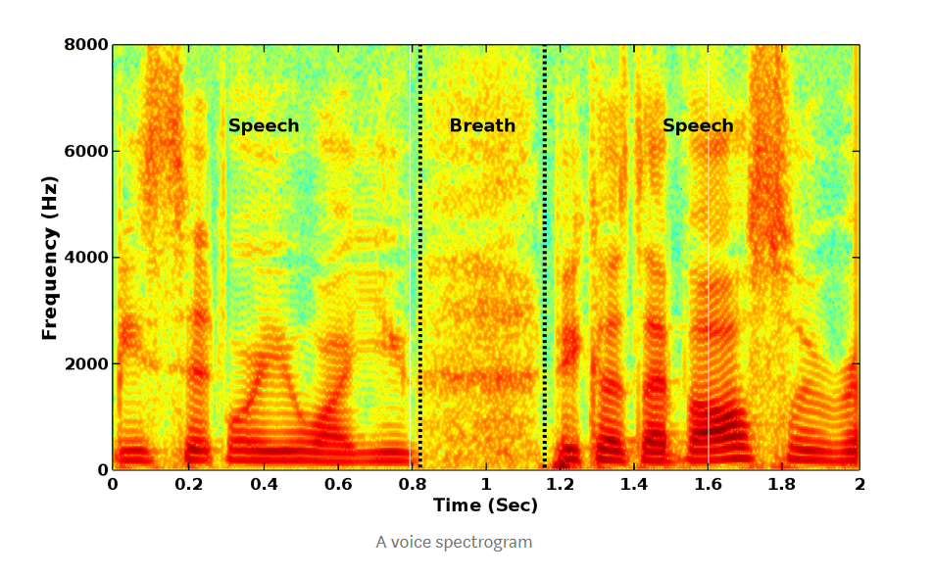
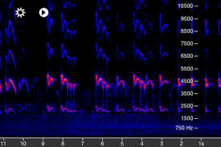
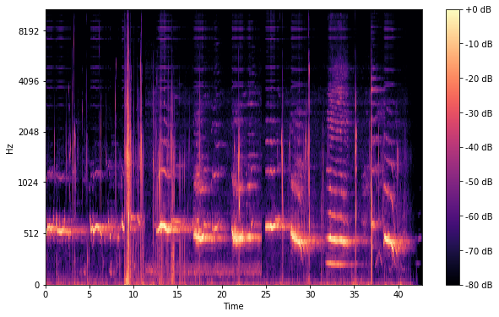

Slide 5
THANKYOU

